Slide 1
Curriculum Night
Mrs. Hahn
Thurston Elementary School
2nd Grade
September 19, 2019
Welcome!

Slide 2
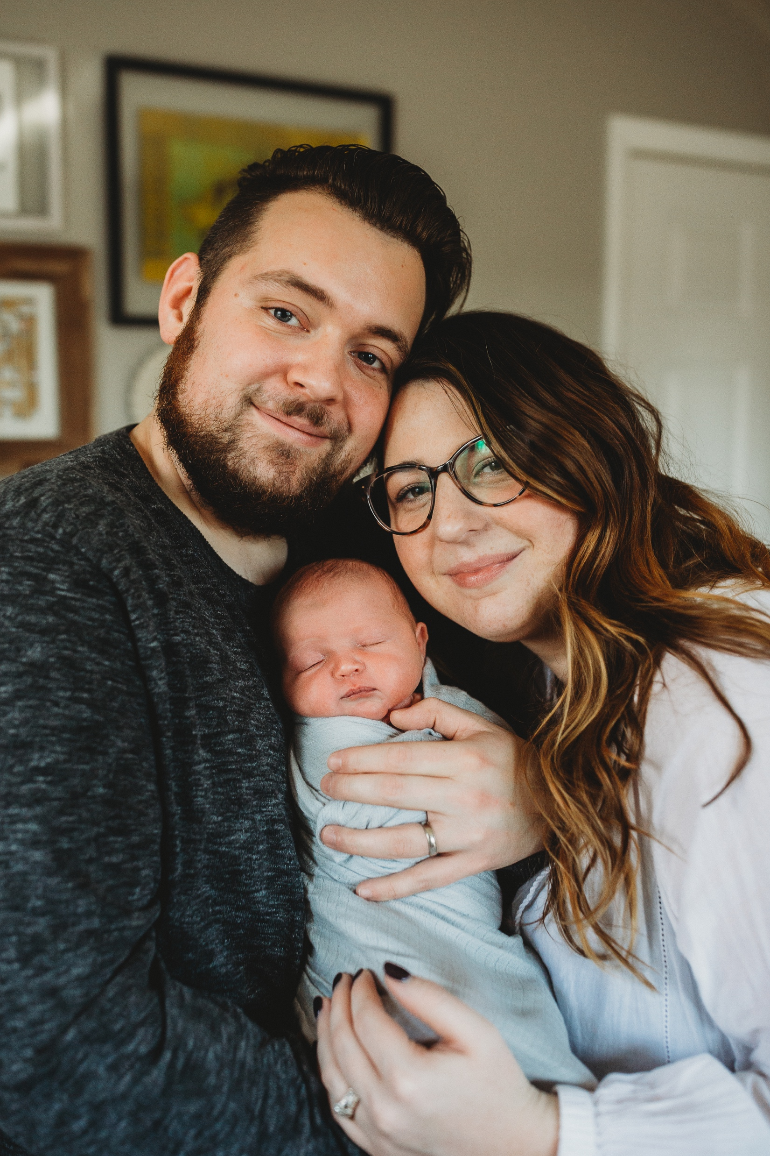
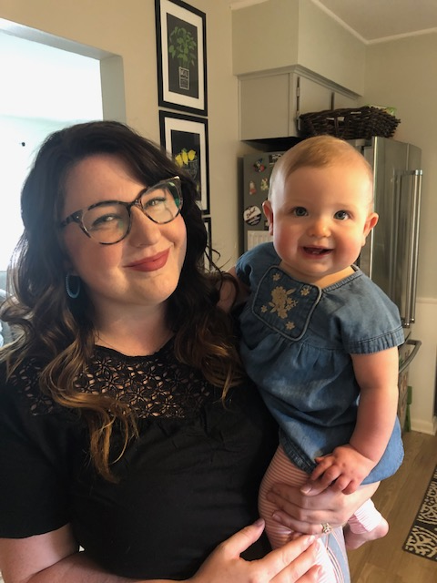
All About Me
3rd Year at Thurston
6th Year Teaching (3 years in 1st grade / 3 years in 2nd grade)
I welcomed my daughter, Coraline (Cora), into the world December 2018. She is almost 10 months old!
I’m completing my master’s degree in curriculum and instruction at EMU. I will graduate this April!
I love to travel and have spent time in Europe and Asia. My husband’s family even lives in South Korea!
I’m a huge Michigan fan. Go BLUE!

Slide 3
Language Arts
Ann Arbor Public Schools uses a Balanced Literacy framework to teach literacy to all students.
The idea of “Balanced Literacy” is, as it sounds, to find balance. We work in multiple areas to provide many opportunities for success.

Slide 4
Reading in Balanced Literacy
The Balanced Literacy framework includes
Phonics,
Guided Reading,
Shared Reading
and Independent Reading.
We use The Reader’s Workshop model to incorporate all of the reading curriculum into our daily learning.

Slide 5
Reader’s Workshop
The reader’s workshop model is a literacy structure that teaches students to apply targeted skills to their own reading and allows time to practice those strategies independently.
It consists of a brief mini-lesson taught by the teacher that models a strategy or reading skill. Immediately after, students practice using the skill while independently reading. Students also have the opportunity to read with a partner, write about reading, and confer with the teacher either one-on-one or with a small group.

Slide 6
Reader’s Workshop
Whole Group
Mini-Lesson on Strategy
Read
Read Independently
Share
Share Strategies Whole Group
Read
Partner Reading
Share
Share Strategies Whole Group

Slide 7
Words their way
Words Their Way is a differentiated spelling program that focuses on the phonetic structures and patterns of words. Rather than memorizing words, we will learn their unique structures for spelling. Students will practice building and sorting words from a differentiated list each week.

Slide 8
Writing in Balanced Literacy
In Writer’s Workshop the students engage in:
Shared Writing,
Interactive Writing,
Informative Writing,
Guided Writing,
Independent Writing.
Three main types of writing assessed:
Narrative
Persuasive and Opinion
Informational

Slide 9
Everyday Mathematics Concepts Covered in 2nd:
• Quickly and accurately adding numbers together that total up to 20
Subtracting from numbers up through 20 with fluency
• Solving one- or two-step word problems by adding or subtracting numbers up through 100
• Understanding what the different digits mean in a three-digit number
• Adding and subtracting three digit numbers
• Measuring lengths of objects in standard units such as inches and centimeters
• Solving addition and subtraction word problems involving length
• Solving problems involving money
• Dividing circles and rectangles into halves, thirds, or fourths
• Solving addition, subtraction, and comparison word problems using information presented in a bar graph/line plot

Slide 10
Math Resources, Structures, & Homework
We use manipulatives and games to provide hands-on learning of math concepts.
Everyday Math lessons-opportunities for students to learn at their own levels.
Teacher guided instruction
Independent work-math journal/math boxes
Games
Home Links –
Math homework (Tuesday-Monday/self-paced)
Xtramath Website
Dreambox
ConnectEd
Spiraling Curriculum - Concepts are brought back over the course of the school year until mastery is achieved.
Small group instruction

Slide 11
Science Units
Earth’s Surfaces
Life Cycles
Project Lead the Way (PLTW)
Grids and Games/Properties of Matter
Hands-on Learning Experiences and Engineering Practices

Slide 12
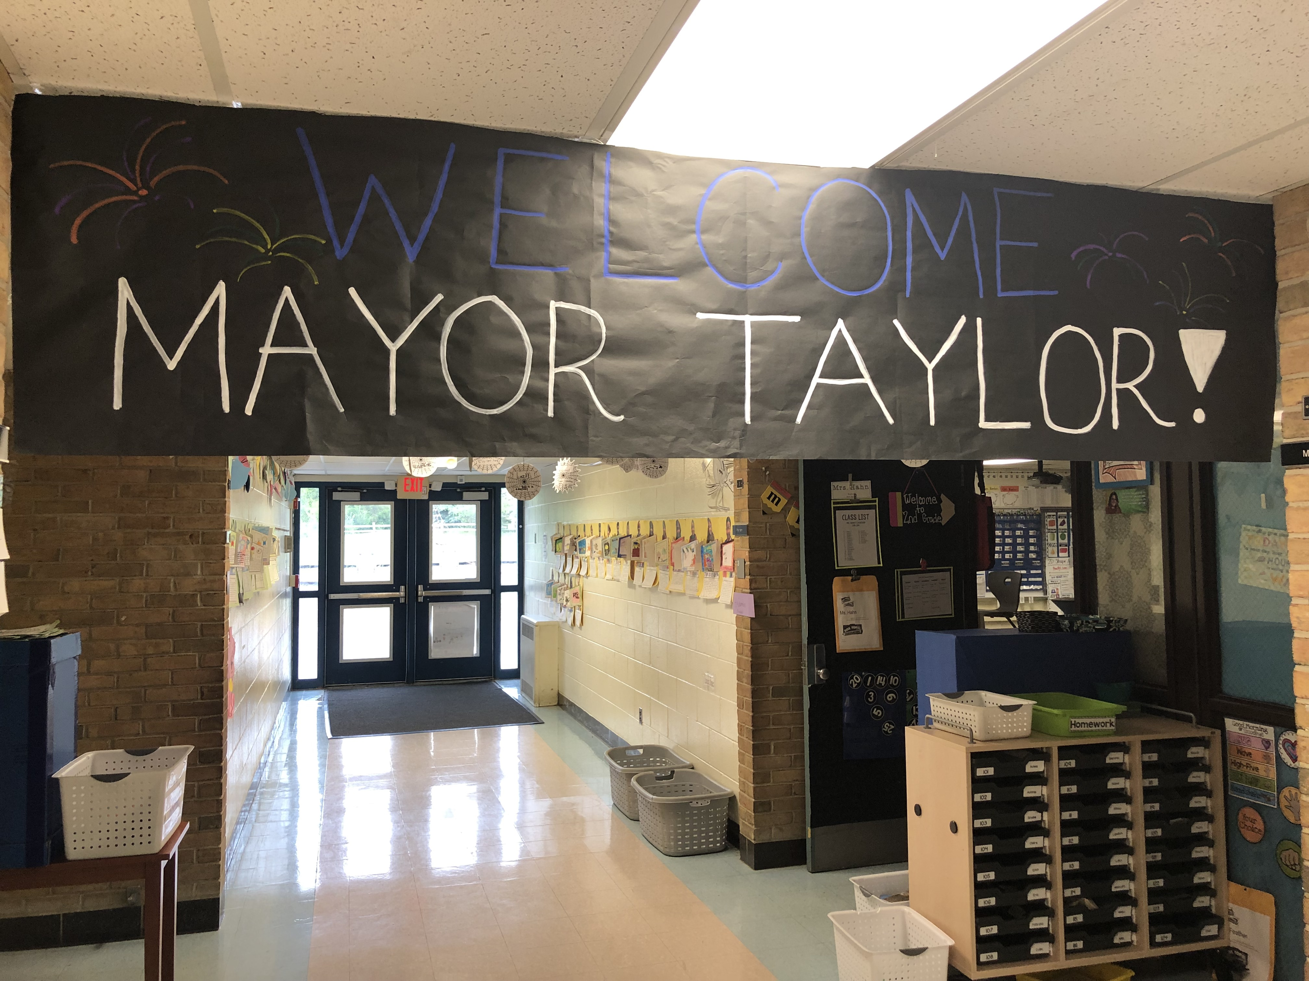
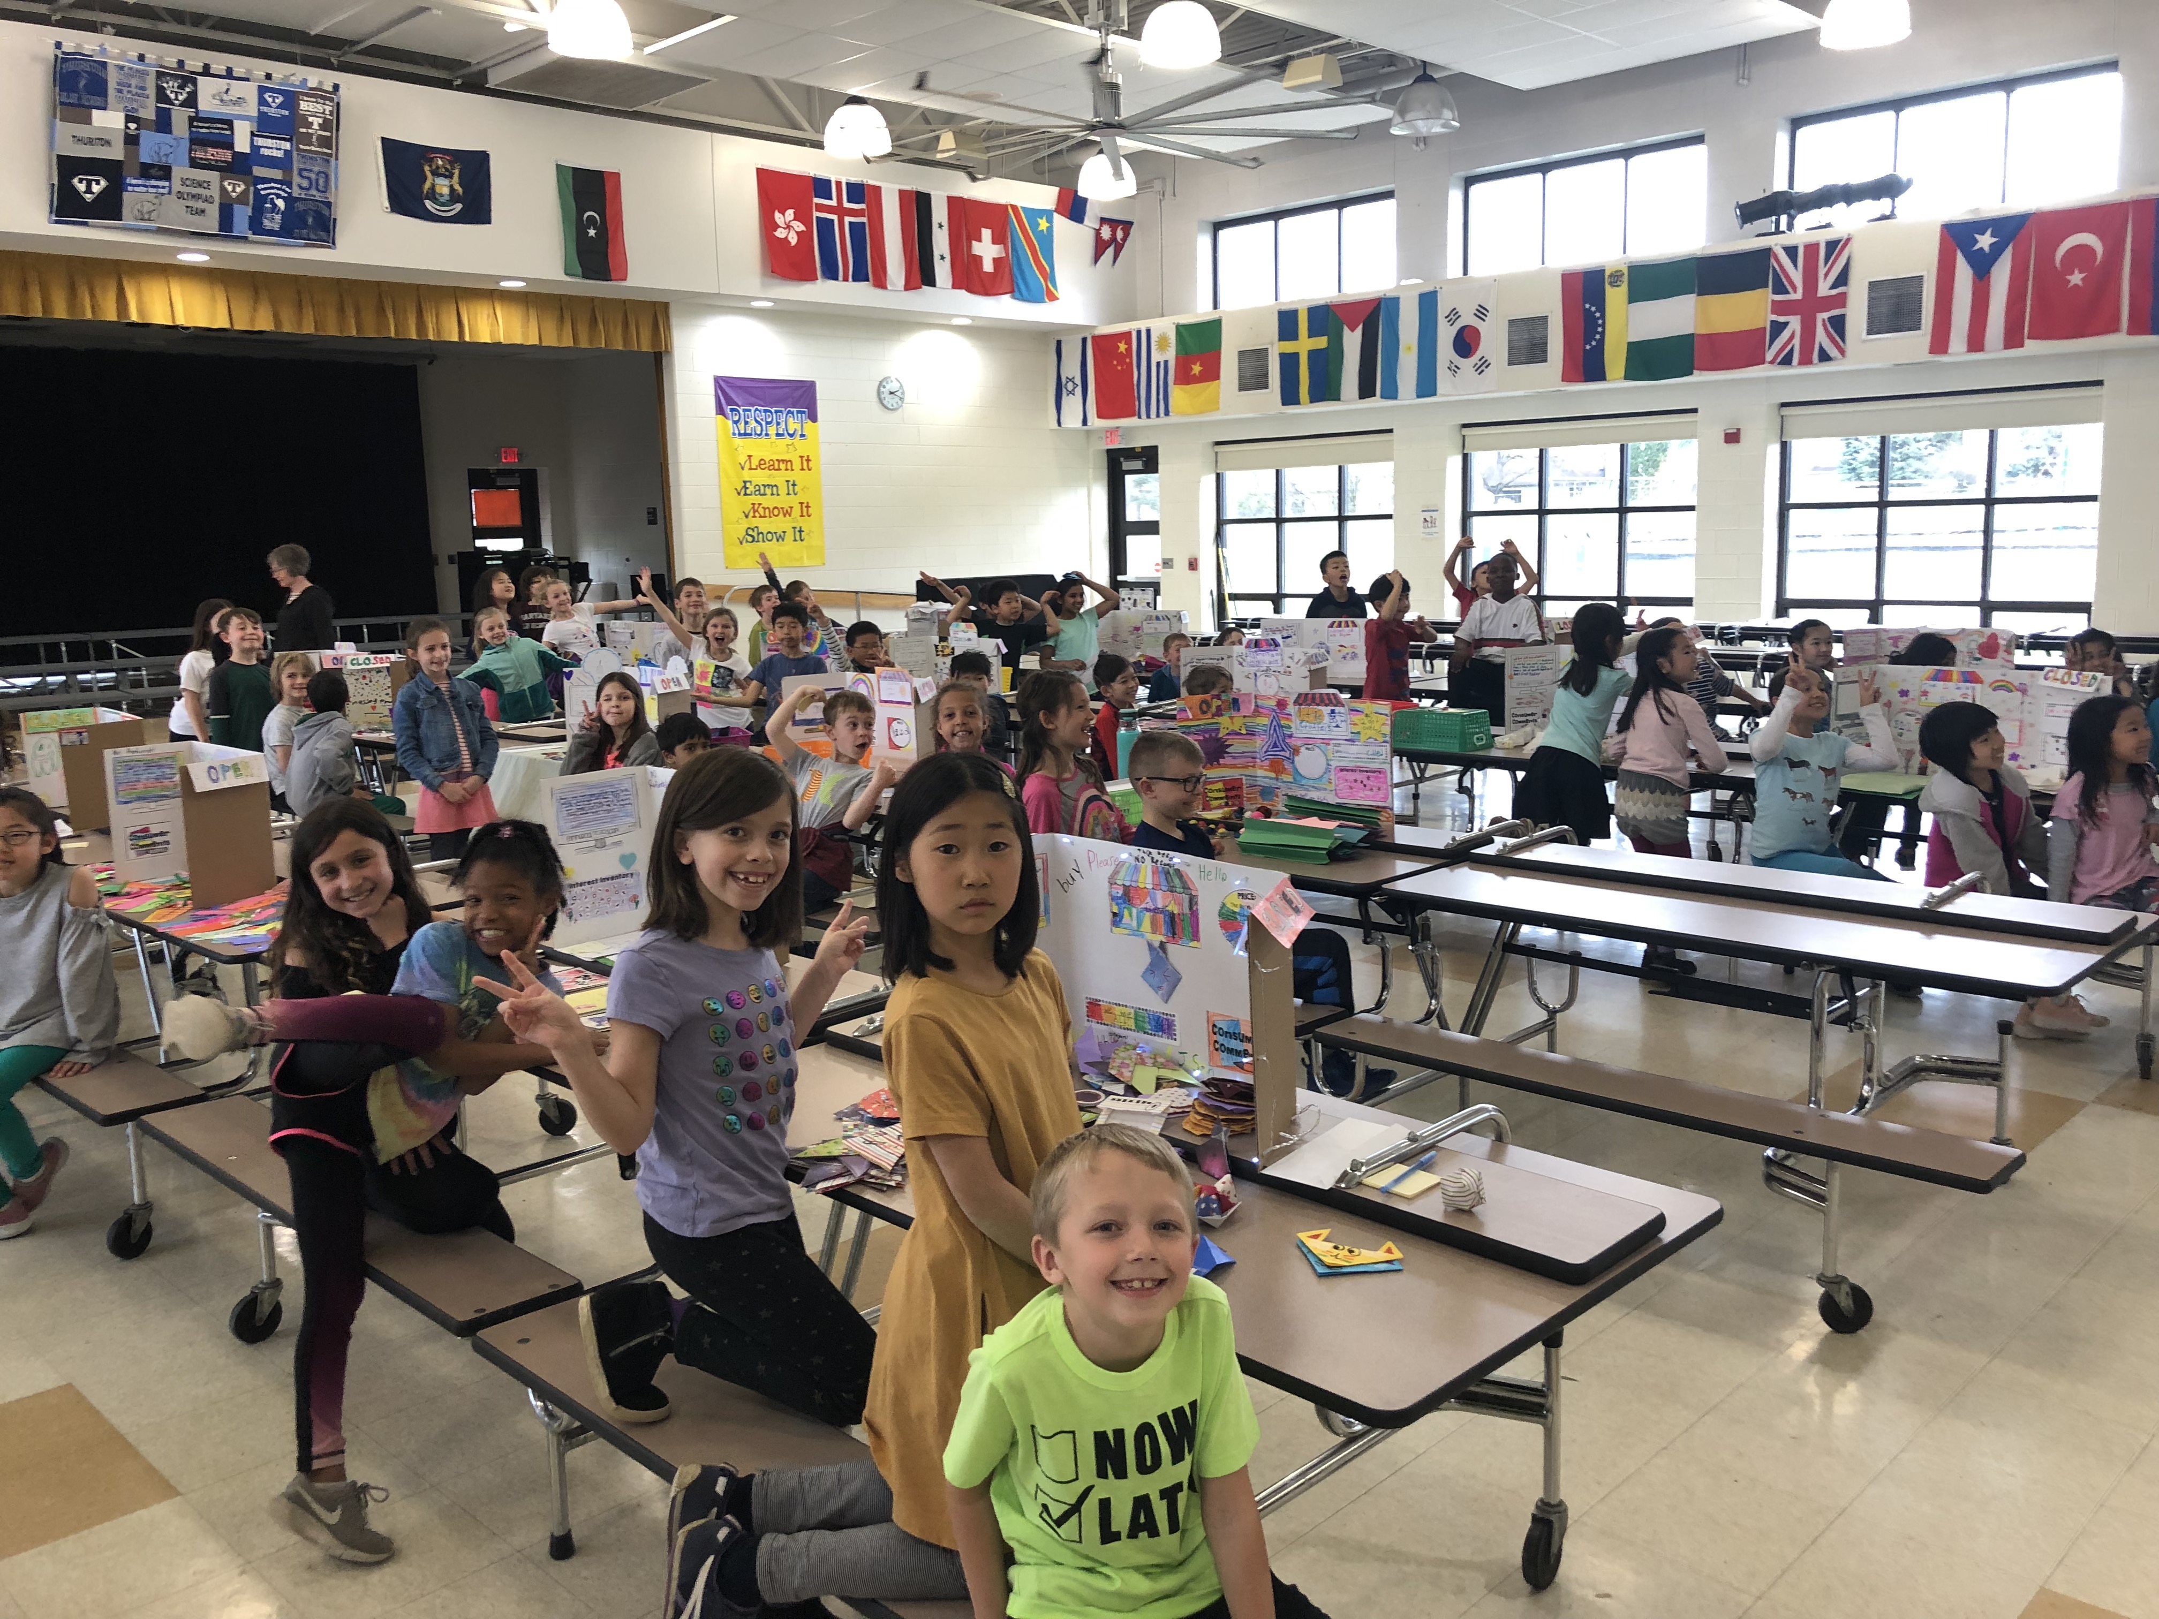
Social Studies
Ann Arbor Public Schools uses a new curriculum called Project Place that emphasizes an interdisciplinary, inquiry approach to real-life topics and place-based learning.
Areas of inquiry include:
- Communities,
- Geography,
- History,
- Economics
-Civics and Government.

Slide 13
Responsive Classroom
How might the Responsive Classroom approach look and sound in my child’s classroom?
The Responsive Classroom approach offers practical strategies for teaching, rather than formulas telling teachers what they must do in the classroom. Teachers adapt the strategies as needed to address their students’ needs, so things may look a bit different in each classroom.
But you’ll usually see and hear teachers:
Conducting Morning Meeting
Treating mistakes in a positive way. (Growth Mindset!!)
Using positive language.
Choices in their learning.
Opportunities to reflect

Slide 14
Responsive Classroom Rules and Behavior
What about classroom rules?
During the early weeks of school, teacher and students create rules based on the students’ goals for learning. Students follow the rules more willingly because they helped to make them. Teachers refer to the rules many times throughout the day and year, helping students understand how following the rules helps everyone to learn. Some schools also have a few basic schoolwide rules that everyone follows in the hallways, lunchroom, and other common spaces. (Be safe, Be responsible, Be respectful)
What if my child breaks the rules?
Teachers understand that all students will, at one time or another, test or break the rules. When that happens, teachers discipline firmly but kindly and positively.
Positive language.
Reminding language (Karen, what should you be doing right now?).
Redirecting language (Mike, hands in your lap).
Reinforcing language (I noticed that you cleaned up very quickly today).
Teachers also make sure that the consequences for misbehavior are related to the misbehavior and respectful of the child. (You break it, you fix it, Loss of Privilege)

Slide 15
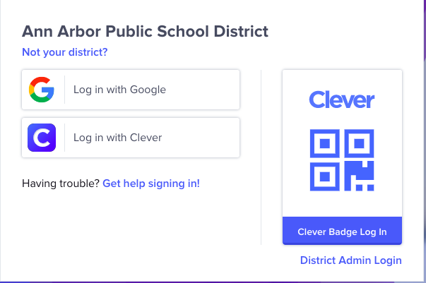
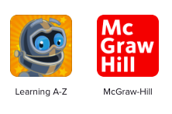
Homework
Homework will be given every Tuesday and is due every Monday.
Students are responsible for completing the home links that correlate to the weekly math lessons.
Additionally, students must read 20 minutes each night and fill out a reading log.
Clever codes will be sent home for you to access applications provided by the district such as:
- Lexia
-Raz-Kids
-ConnectEd (Everyday Math games)
-SeeSaw
-Dreambox
-And much more!!!

Slide 16
Field Trips
Ann Arbor District Library
Wild Swan Theater
Life Cycle Walk-Botanical Gardens
Visit to a Local Business – Jiffy Plant

Slide 17
Healthy Snacks/Birthdays
*Each day we will have ONE snack. Please try to make sure to send your child in with a healthy snack that can be eaten within 10 minutes.
*We will ALWAYS accept donations for snack. This allows each and every child a nutritious pick-me-up for learning. I will notify you via my newsletter or Remind message asking for donations when needed!
*Due to allergies, our classroom is nut-free.
*Non-food birthday treats for the school.

Slide 18
Email hahnk@aaps.k12.mi.us Travel Folders sent home Tuesday, return each day Classroom Website www.mrshahnk.weebly.com Twitter @mrshahnk Classtag A Sign-up Genius will be sent for conferences via Classtag and is provided on my website.
Communication

Slide 19
Questions?
Thank you for coming tonight!
Want to view this again? All of the slides will be uploaded to my website:
www.mrshahnk.weebly.com

